Slide 1
UNIT-5
MAP-REDUCE APPLICATIONS
By
Dr. Prasanta Kumar Sahoo
Professor, Dept. Of CSE

Slide 2
UNIT-V
Contents:
MapReduce workflows.
Unit tests with MRUnit.
Anatomy of MapReduce job run.
YARN.
Failures in classic Mapreduce and YARN.
Job scheduling , shuffle and sort ,task execution.

Slide 3
Map Reduce1.0
Main Responsibility are as below:
JOB TRACKER (Receive the request from client).
TASK TRACKER (works under the supervision of JOB tracker, reports the progress of the Job to Job Tracker)

Slide 4
HDFS FILE SYSTEM DESIGN
Scalable Distributed File System: as you add more disks, you get scalable performance. Some times you need to add more and more disks (community hardware) in order to scale out your performance.
Distributed Data on Local Disks on several nodes.
Parallel Processing.
Low cost Community Hardware.

Slide 5
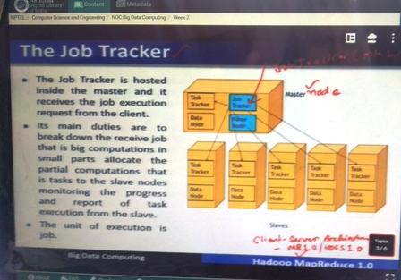
Map Reduce Job Tracker

Slide 6
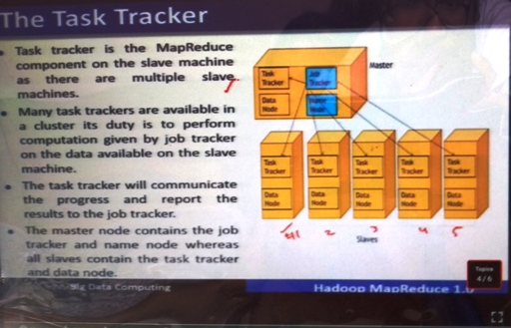
Map Reduce

Slide 7
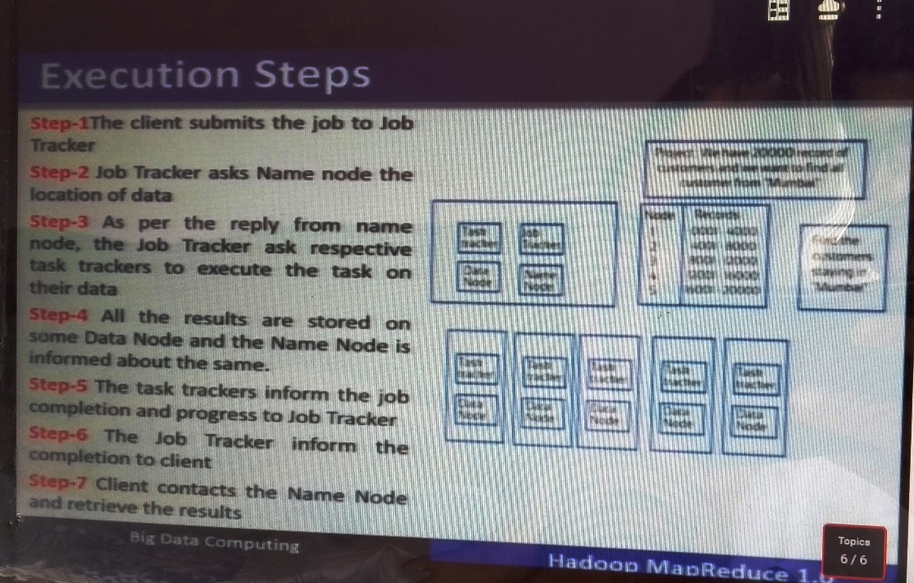

MAP REDUCE WORK FLOWS

Slide 8
Map Reduce Work Flow
Step-1: Client submits Job to Job Tracker.
Step-2: Job Tracker request name node for location of data.
Step-3: Job Tracker creates Execution Plan.
Step-4: Job Tracker submits work to Task Trackers.
Step-5: Job Tracker manages phases.

Slide 9
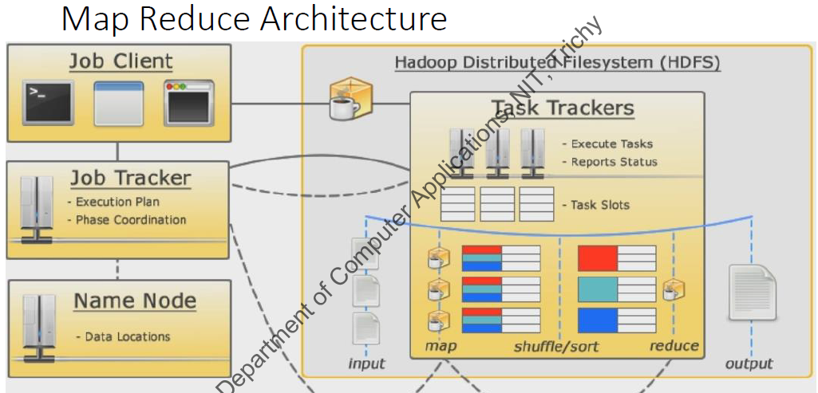

Slide 10
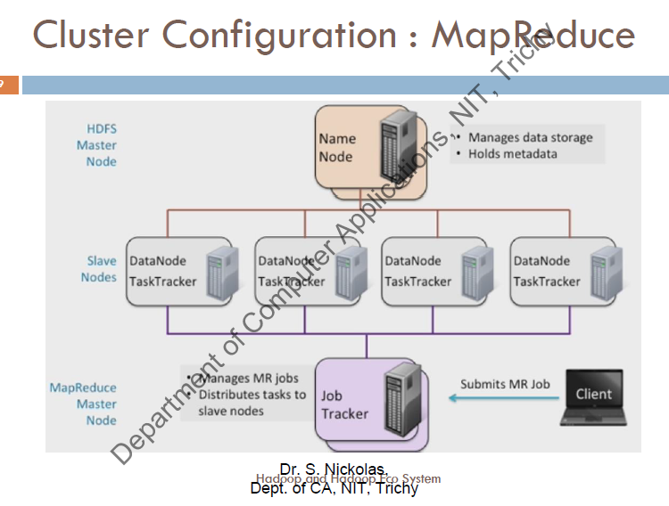

Slide 11
Anatomy of a MapReduce Job Run
The client, which submits the MapReduce job.
The jobtracker, which coordinates the job run. The jobtracker is a Java application whose main class is JobTracker.
The tasktrackers, which run the tasks that the job has been split into. Tasktrackers are Java applications whose main class is TaskTracker.
The distributed filesystem (normally HDFS) which is used for sharing job files between the other entities.

Slide 12
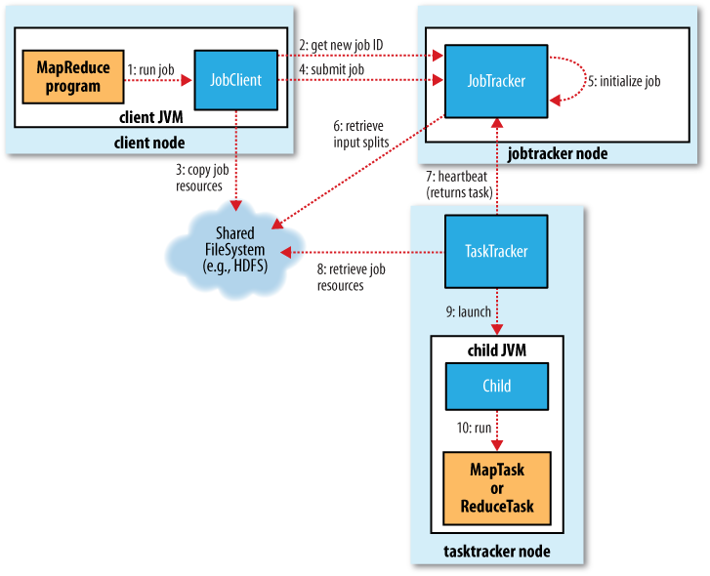

Slide 13
Hadoop YARN
YARN stands for “Yet Another Resource Negotiator“. YARN as the brain of your Hadoop Ecosystem. It performs all your processing activities by allocating resources and scheduling tasks. It was introduced in Hadoop 2.0 to remove the bottleneck on Job Tracker which was present in Hadoop 1.0. YARN was described as a “Redesigned Resource Manager” at the time of its launching, but it has now evolved to be known as large-scale distributed operating system used for Big Data processing.

Slide 14
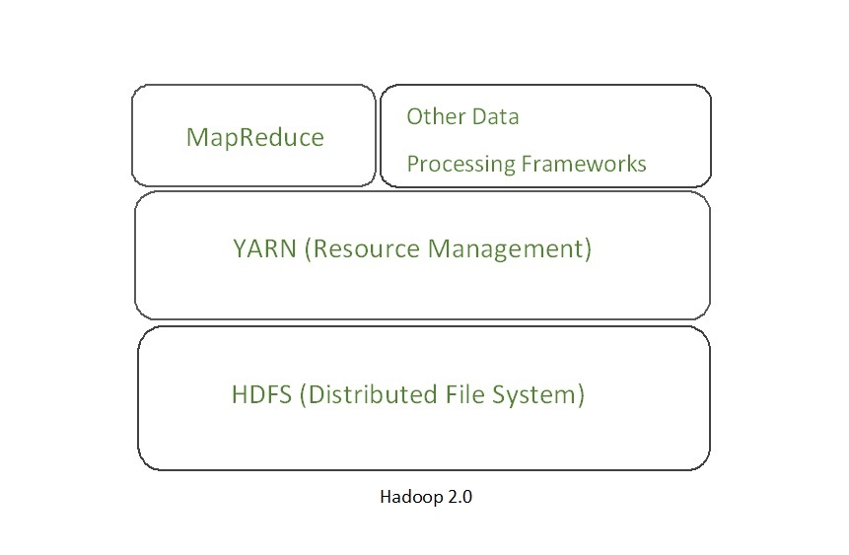
Hadoop YARN Architecture

Slide 15
YARN
YARN architecture basically separates resource management layer from the processing layer. In Hadoop 1.0 version, the responsibility of Job tracker is split between the resource manager and application manager.
YARN also allows different data processing engines like graph processing, interactive processing, stream processing as well as batch processing to run and process data stored in HDFS (Hadoop Distributed File System) thus making the system much more efficient. Through its various components, it can dynamically allocate various resources and schedule the application processing.

Slide 16
Main components of YARN architecture.
Client: It submits map-reduce jobs.
Resource Manager: It is the master daemon of YARN and is responsible for resource assignment and management among all the applications. Whenever it receives a processing request, it forwards it to the corresponding node manager and allocates resources for the completion of the request accordingly.

Slide 17
Resource Manager
It has two major components:
Scheduler: It performs scheduling based on the allocated application and available resources. It is a pure scheduler.
Application manager: It is responsible for accepting the application and negotiating the first container from the resource manager. It also restarts the Application Manager container if a task fails.

Slide 18
Yarn components
Node Manager: It take care of individual node on Hadoop cluster and manages application and workflow and that particular node. It monitors resource usage, performs log management and also kills a container based on directions from the resource manager. It is also responsible for creating the container process and start it on the request of Application master.

Slide 19
Application Master
Application Master: An application is a single job submitted to a framework. The application manager is responsible for negotiating resources with the resource manager, tracking the status and monitoring progress of a single application. Once the application is started, it sends the health report to the resource manager from time-to-time.

Slide 20
Container
Container: It is a collection of physical resources such as RAM, CPU cores and disk on a single node. The containers are invoked by Container Launch Context(CLC) which is a record that contains information such as environment variables, security tokens, dependencies etc.

Slide 21
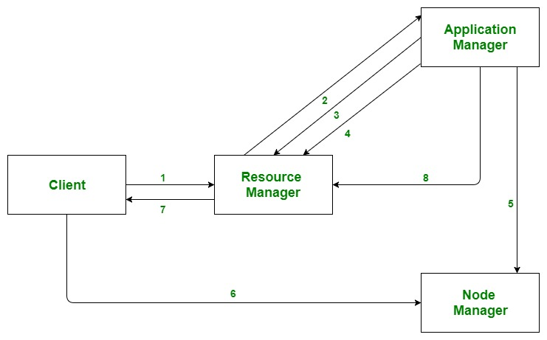
YARN workflow

Slide 22
YARN workflow
Client submits an application.
The Resource Manager allocates a container to start the Application Manager.
The Application Manager registers itself with the Resource Manager.
The Application Manager negotiates containers from the Resource Manager.
The Application Manager notifies the Node Manager to launch containers.

Slide 23
YARN workflow
Application code is executed in the container.
Client contacts Resource Manager/Application Manager to monitor application’s status.
Once the processing is complete, the Application Manager un-registers with the Resource Manager.

Slide 24
YARN Features
Scalability: The scheduler in Resource manager of YARN architecture allows Hadoop to extend and manage thousands of nodes and clusters.
Compatability: YARN supports the existing map-reduce applications without disruptions thus making it compatible with Hadoop 1.0 as well.
Cluster Utilization:Since YARN supports Dynamic utilization of cluster in Hadoop, which enables optimized Cluster Utilization.
Multi-tenancy: It allows multiple engine access thus giving organizations a benefit of multi-tenancy.

Slide 25
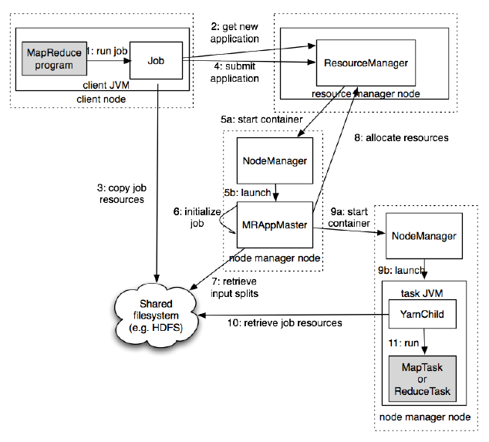
How Hadoop runs a MapReduce job using YARN

Slide 26
Map Reduce Work Flow – Theory way
Decomposing a Problem into MapReduce Jobs
JobControl

Slide 27
Steps in MapReduce Application Development
Configuring the development environment
Writing Unit Test
  Mapper
  Reducer
Running on the local machine
Running on the cluster
Tuning a job

Slide 28
Observed Setbacks in configuring development environment for the first time – Linux Ubuntu – Single Node Cluster
Operating System
RAID configurations
Software Installation (Offline/Online)
Java Installation
DNS Server Requirement
Static Network Configuration
No Firewall in Ubuntu
Localhost
Username

Slide 29
Failures in Classic MapReduce
Task Failure
Tasktracker Failure
Jobtracker Failure

Slide 30
Failures in YARN
Task Failure
Application Master Failure
Node Manager Failure
Resource Manager Failure

Slide 31
Job Scheduling
FIFO Scheduling of jobs in earlier Hadoop.
The job scheduler selects one with the highest priority when it is choosing the next job to run.
Priorities do not support preemption with FIFO scheduler in Hadoop.

Slide 32

TYPES OF HADOOP SCHEDULERS

Slide 33
When to Use Each Scheduler in Hadoop?
Capacity scheduler is the right choice while we want to ensure guaranteed access with the potential in order to reuse unused capacity as well as prioritize jobs within queues, while we are running a large Hadoop cluster, along with the multiple clients.

Slide 34
When we use both small and large clusters for the same organization with a limited number of workloads, the fair scheduler works well

Slide 35
Shuffle and Sort
MapReduce makes the guarantee that the input to every reducer is sorted by key.
The process by which the system performs the sort and transfers the map outputs to the reducers as inputs is known as the shuffle.
The shuffle is an area of the codebase where refinements and improvements are continually being made.
In many ways, the shuffle is the heart of MapReduce and is where the “magic” happens.

Slide 36
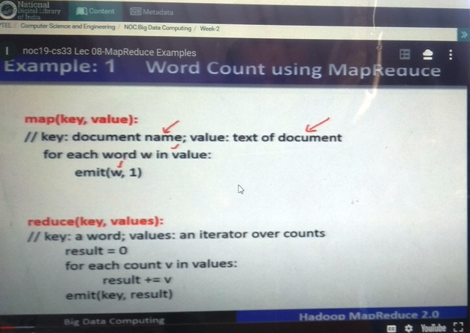
Example Program

Slide 37
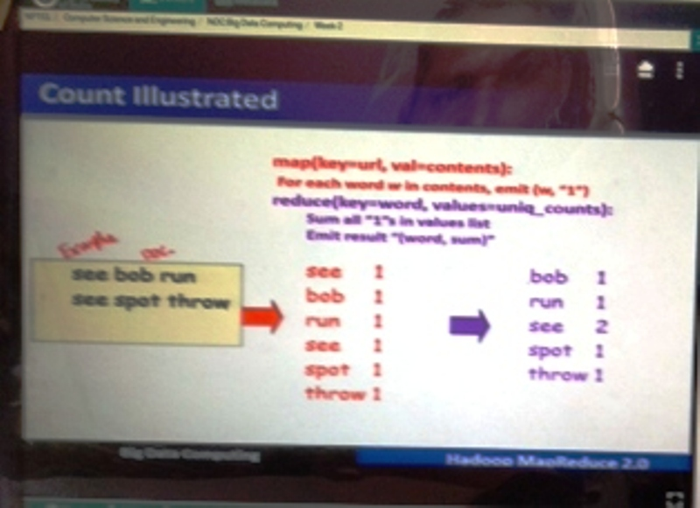
Example 1

Slide 38
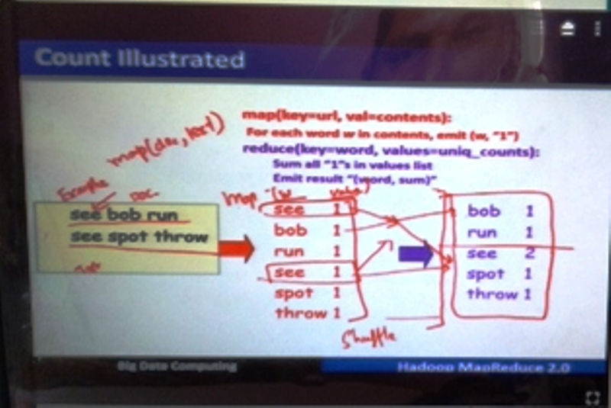
Sorting and shuffling

Slide 39
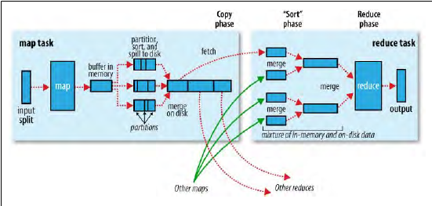
The Map Side and The Reduce Side

Slide 40
Task Execution
Speculative Execution
  A Job with slow-running tasks takes longer time to complete successfully.
  Hadoop doesn’t try to diagnose and fix slow-running tasks.
  Instead, it tries to detect when a task is running slower than expected and launches another, equivalent, task as a backup.
  This is termed speculative execution of tasks.
  If the original task completes before the speculative task, then the speculative task is killed; on the other hand, if the speculative task finishes first, then the original is killed.

Slide 41
Task JVM Reuse
Hadoop runs tasks in their own Java Virtual Machine to isolate them from other running tasks.
The overhead of starting a new JVM for each task can take around a second, which for jobs that run for a minute or so is insignificant.
However, jobs that have a large number of very short-lived tasks (these are usually map tasks), or that have lengthy initialization, can see performance gains when the JVM is reused for subsequent tasks.
With task JVM reuse enabled, tasks do not run concurrently in a single JVM. The JVM runs tasks sequentially. Tasktrackers can, however, run more than one task at a time, but this is always done in separate JVMs.

Slide 42
Skipping Bad Records
Large datasets are messy. They often have corrupt records. They often have records that are in a different format. They often have missing fields.
In an ideal world, your code would cope gracefully with all of these conditions. In practice, it is often expedient to ignore the offending records.
Depending on the analysis being performed, if only a small percentage of records are affected, then skipping them may not significantly affect the result. However, if a task trips up when it encounters a bad record by throwing a runtime exception then the task fails.
Failing tasks are retried (since the failure may be due to hardware failure or some other reason outside the task’s control), but if a task fails four times, then the whole job is marked as failed.
If it is the data that is causing the task to throw an exception, rerunning the task won’t help, since it will fail in exactly the same way each time.

Slide 43
The best way to handle corrupt records is in your mapper or reducer code. You can detect the bad record and ignore it, or you can abort the job by throwing an exception.
You can also count the total number of bad records in the job using counters to see how widespread the problem is. In rare cases, though, you can’t handle the problem because there is a bug in a third party library that you can’t work around in your mapper or reducer. In these cases, you can use Hadoop’s optional skipping mode for automatically skipping bad records.
When skipping mode is enabled, tasks report the records being processed back to the tasktracker. When the task fails, the tasktracker retries the task, skipping the records that caused the failure.
Because of the extra network traffic and bookkeeping to maintain the failed record ranges, skipping mode is turned on for a task only after it has failed twice.

Slide 44
Thus, for a task consistently failing on a bad record, the tasktracker runs the following task attempts with these outcomes:
Task fails.
Task fails.
Skipping mode is enabled. Task fails, but failed record is stored by the tasktracker.
Skipping mode is still enabled. Task succeeds by skipping the bad record that failed in the previous attempt.

Slide 45
Bad records that have been detected by Hadoop are saved as sequence files in the job’s output directory under the _logs/skip subdirectory. These can be inspected for diagnostic purposes after the job has completed.

Slide 46
MR unit
Setup: Download the latest version of MRUnit jar from Apache website: https://repository.apache.org/content/repositories/releases/org/apache/mrunit/mrunit/. For example if you are using the Hadoop version 1.0.3, download mrunit-x.x.x-incubating-hadoop2.jar.

Slide 47
MR unit test
Writing MRUnit test cases
MRUnit testing framework is based on JUnit and it can test Map Reduce programs written on 0.20 , 0.23.x , 1.0.x , 2.x version of Hadoop.

Slide 48
Word count code
import java.util.ArrayList;
import java.util.List;
import org.apache.hadoop.io.IntWritable;
import org.apache.hadoop.io.LongWritable;
import org.apache.hadoop.io.Text;
import org.apache.hadoop.mrunit.MapDriver;
import org.apache.hadoop.mrunit.MapReduceDriver;
import org.apache.hadoop.mrunit.ReduceDriver;

Slide 49
Class test Word Count
import org.junit.Before;
import org.junit.Test;
public class TestWordCount {
MapReduceDriver<LongWritable, Text, Text, IntWritable, Text, IntWritable> mapReduceDriver;
MapDriver<LongWritable, Text, Text, IntWritable> mapDriver;
ReduceDriver<Text, IntWritable, Text, IntWritable> reduceDriver;

Slide 50
Setup
Before public void setUp() {
WordMapper mapper = new WordMapper();
SumReducer reducer = new SumReducer();
mapDriver = new MapDriver<LongWritable, Text, Text, IntWritable>();
mapDriver.setMapper(mapper);
reduceDriver = new ReduceDriver<Text, IntWritable, Text, IntWritable>();
reduceDriver.setReducer(reducer);
mapReduceDriver = new MapReduceDriver<LongWritable, Text, Text, IntWritable, Text, IntWritable>();
mapReduceDriver.setMapper(mapper);
mapReduceDriver.setReducer(reducer);
}

Slide 51
Test Mapper class
@Test public void testMapper() {
mapDriver.withInput(new LongWritable(1), new Text("cat cat dog"));
mapDriver.withOutput(new Text("cat"), new IntWritable(1));
mapDriver.withOutput(new Text("cat"), new IntWritable(1));
mapDriver.withOutput(new Text("dog"), new IntWritable(1));
mapDriver.runTest();
}

Slide 52
Test reducer class
@Test public void testReducer() {
List<IntWritable> values = new ArrayList<IntWritable>();
values.add(new IntWritable(1));
values.add(new IntWritable(1));
reduceDriver.withInput(new Text("cat"), values);
reduceDriver.withOutput(new Text("cat"), new IntWritable(2));
reduceDriver.runTest();
}

Slide 53
Test both map & reduce
@Test public void testMapReduce() {
mapReduceDriver.withInput(new LongWritable(1), new Text("cat cat dog"));
mapReduceDriver.addOutput(new Text("cat"), new IntWritable(2));
mapReduceDriver.addOutput(new Text("dog"), new IntWritable(1));
mapReduceDriver.runTest();
}
}

Slide 54
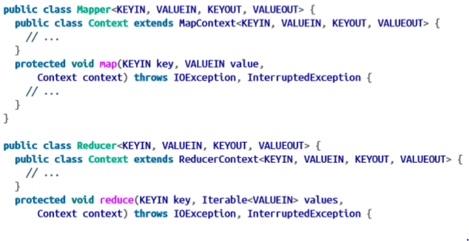
MapReduce Form Review
General form of Map/Reduce functions:
  map: (K1, V1) -> list(K2, V2)
  reduce: (K2, list(V2)) -> list(K3, V3)
General form with Combiner function:
  map: (K1, V1) -> list(K2, V2)
  combiner: (K2, list(V2)) -> list(K2, V2)
  reduce: (K2, list(V2)) -> list(K3, V3)
Partition function:
  partition: (K2, V2) -> integer
Notes:
Pratik

Slide 55
Input Formats - Basics
Input split - a chunk of the input that is processed by a single map
  Each map processes a single split, which is divided into records (key-value pair) that are individually processed by the map
  Represented by Java class InputSplit
    Set of storage locations (hostname strings)
    Contains reference to the data not the actual data
InputFormat - responsible for creating input splits and dividing them into records so you will not directly deal with with the InputSplit class
Controlling split size
  Usually the size of the HDFS block
    Minimum size: 1 byte
    Maximum size: Maximum value of Java long datatype
  Split size formula: max(minimumSize, min(maximumSize, blockSize))
    minimumSize < blockSize < maximumSize
Notes:
Candace Allison

Slide 56
Input Formats - Basics
Avoid small files - storing a large number of small files increases the numbers of seeks needed to run the job
  A sequence file can be used to merge small files into larger files to avoid a large number of small files
Preventing splitting - you might want to prevent splitting if you want a single mapper to process each input file as an entire file
  1. Increase the minimum split size to be larger than the largest file in the system
  2. Subclass the subclass of FileInputFormat to override the isSplitable() method to return false
Reading an entire file as a record:
  RecordRecorder - deliver file contents as the value of the record, must implement createRecordReader() to create a custom implementation of the class
  WholeFileInputFormat
Notes:
Candace Allison

Slide 57
Input Formats - File Input
FileInputFormat - the base class for all implementations of InputFormat that use a file as the source for data
  Provides a place to define what files are included as input to a job and an implementation for generating splits for the input files
  Input is often specified as a collection of paths
  Splits large files (larger than HDFS block)
CombineFileInputFormat - Java class designed to work well with small files in Hadoop
  Each split will contain many of the small files so that each mapper has more to process
  Takes node and rack locality into account when deciding what blocks to place into the same split
WholeFileInputFormat - defines a format where the keys are not used and the values are the file contents
  Takes a FileSplit and converts it into a single record
Notes:
Abdulla Albuenain

Slide 58
Input Formats - Text Input
TextInputFormat - default InputFormat where each record is a line of input
  Key - byte offset within the file of the beginning of the line; Value - the contents of the line, not including any line terminators, packaged as a Text object
  mapreduce.input.linerecordreader.line.maxlength - can be used to set a maximum expected line length
    Safeguards against corrupted files (often appears as a very long line)
KeyValueTextInputFormat - Used to interpret TextOutputFormat (default output that contains key-value pairs separated by a delimiter)
  mapreduce.input.keyvaluelinerecordreader.key.value.separator - used to specify the delimiter/separator which is tab by default
NLineInputFormat - used when the mappers need to receive a fixed number of lines of input
  mapreduce.input.line.inputformat.linespermap - controls the number of input lines (N)
StreamXmlRecordReader - used to break XML documents into records
Notes:
Abdulla Albuenain

Slide 59
Input Formats - Binary Input, Multiple Inputs, and Database I/O
Binary Input:
  SequenceFileInputFormat - stores sequences of binary key-value pairs
  SequenceFileAsTextInputFormat - converts sequence file’s keys and values to Text objects
  SequenceFileAsBinaryInputFormat - retrieves the sequence file’s keys and values as binary objects
  FixedLengthInputFormat - reading fixed-width binary records from a file where the records are not separated by delimiters
Multiple Inputs:
  All input is interpreted by a single InputFormat and a single Mapper
  MultipleInputs - allows programmer to specify which InputFormat and Mapper to use on a per-path basis
Database Input/Output:
  DBInputFormat - input format for reading data from a relational database
  DBOutputFormat - output format for outputting data from a relational database
Notes:
Ruchee

Slide 60
Output Formats
Text Output: TextOutputFormat - default output format; writes records as lines of text (keys and values are turned into strings)
  KeyValueTextInputFormat - breaks lines into key-value pairs based on a configurable separator
Binary Output:
  SequenceFileOutputFormat - writes sequence files as output
  SequenceFileAsBinaryOutputFormat - writes keys and values in binary format into a sequence file container
  MapFileOutputFormat - writes map files as output
Multiple Outputs:
  MultipleOutputs - allows programmer to write data to files whose names are derived from output keys and values to create more than one file
Lazy Output: LazyOutputFormat - wrapper output format that ensures the output file is created only when the first record is emitted for a given partition
Notes:
Ruchee

Slide 61
Counters
Useful for gathering statistics about a job, quality-control, and problem diagnosis
Built-in Counter Types:
  Task Counters - gather info about tasks as they are executed and results are aggregated over all job tasks
    Maintained by each task attempt and are sent to the application manager on a regular basis to be globally aggregated
    May go down if a task fails
  Job Counters - measure job-level statistics and are maintained by the application master so they do not need to be sent across the network
User-Defined Counters: User can define a set of counters to be incremented in a mapper/reducer function
  Dynamic counters (not defined by Java enum) can be created by the user
Notes:
Fahad Aldosari

Slide 62
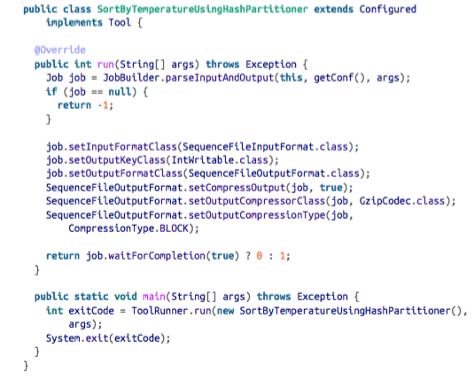
Sorting
Partial Sort - does not produce a globally-sorted output file
Total Sort - produces a globally-sorted output file
  Produce a set of sorted files that can be concatenated to form a globally-sorted file
  To do this: use a partitioner that respects the total order of the output and the partition sizes must be fairly even
Secondary Sort - Sorts the values of the keys
  These are usually not sorted by MapReduce
Notes:
Fahad Aldosari

Slide 63
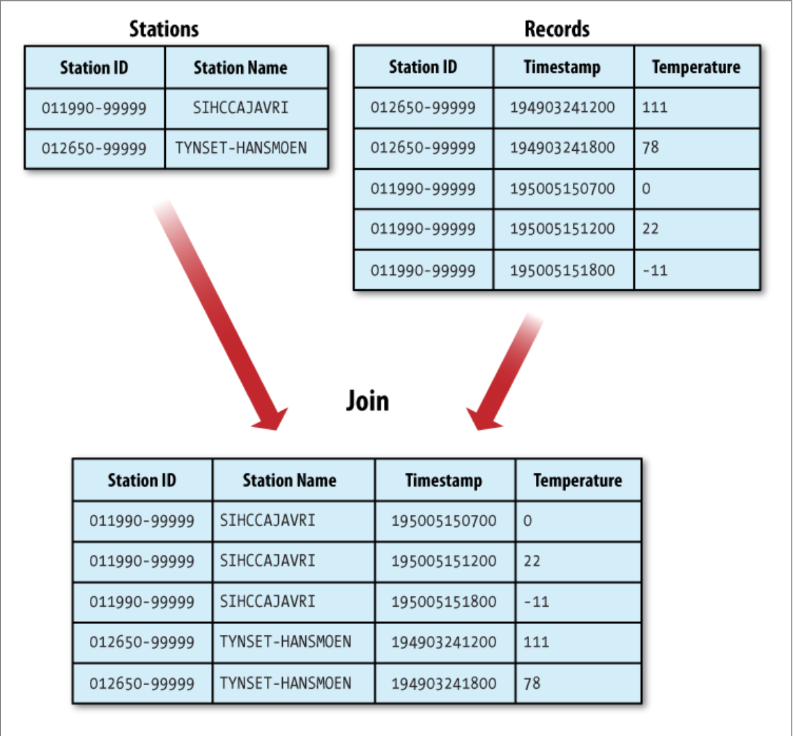
Joins
MapReduce can perform joins between large datasets.
Ex:
Notes:
Azzahra Alsaif

Slide 64
Joins - Map-Side vs Reduce-Side
Map-Side Join
Reduce-Side Join
  the inputs must be divided into the same number of partitions and sorted by the same key (the join key)
  All the records for a particular key must reside in the same partition
  CompositeInputFormat can be used to run a map-side join
  Input datasets do not have to be structured in a particular way
  Results in records with the same key being brought together in the reducer function
  Uses MultipleInputs and a secondary sort
Notes:
Azzahra Alsaif

Slide 65
Side Data Distribution
Side Data - extra read-only data needed by a job to process the main dataset
  The main challenge is to make side data available to all the map or reduce tasks (which are spread across the cluster) in way that is convenient and efficient
Using the Job Configuration
  Configuration is a setter method used to set key-value pairs in the job configuration
  Useful for passing metadata to tasks
Distributed Cache
  Instead of serializing side data in the job config, it is preferred to distribute the datasets using Hadoop’s distributed cache
    Provides a service for copying files and archives to the task nodes in time for the tasks to use them when they run
  2 types of objects can be placed into cache:
    Files
    Archives
Notes:
Kevin

Slide 66
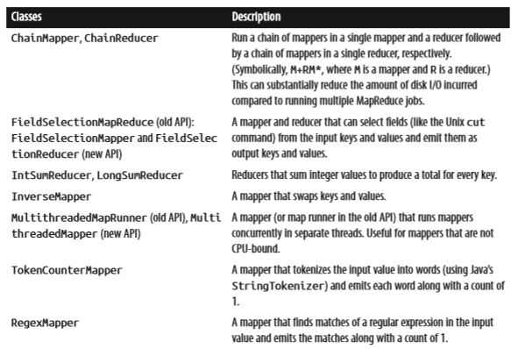
MapReduce Library Classes
Mappers/Reducers for commonly-used functions:
Notes:
Kevin

Slide 67

Video – Example MapReduce WordCount
Video: https://youtu.be/aelDuboaTqA

